Slide 1
Health information, treatment, and worker productivity
Andrew Dillon, Jed Friedman, Pieter Serneels
Journal of the European Economic Association

Slide 2
Motivation
Agricultural productivity is considered key for growth and economic development in low income countries
Health is seen as a critical component of human capital… but economic gains from health investment often difficult to measure
  Existing literature focuses often on benefits from investment in child health
  Does investment in adult health increase productivity and income, and by how much?
  Scarce existing evidence suggests potentially substantial effects
Focus on malaria
  remains a significant illness worldwide, especially in sub-Saharan Africa
  biological impacts can be severe
  previous work estimates a non-trivial cost of malaria related to absenteeism from work: 1-5 days /episode
Notes:
Importance of agric productivity
Much attention for technological innovation,
now also for human capital and especially health
Does investment in health increase productivity?
and if so, by how much, and why do we not see more investment?
Macro studies
-Recent macro economic evidence suggests small effects of health on growth (Acemoglu and Johnson 2006; Ashraf, Lester and Weil 2008; Weil 2008)
-Negative relationship with GDP pc, savings, FDI (McCarthy et al (2000), Gallup and Sachs (2001); Sachs and Malaney (2002), Sachs (2003), Carsten and Gundlach (2006); Bhattacharyya (2009); Azemar and Desbordes (2009)-
But cross country regressions
A number of macro economic studies suggest that health in general and malaria in specific, can have strong effects on economic outcomes (a.o. Sachs, 2001)
But their evidence relies on cross country regressions which may suffer from omitted variable bias and reverse causality problems
Recent work on the effect of health on growth finds surprisingly small effects (Acemoglu, Johnson and Robinson (2001); Ashraf, Lester and Weil (2008); Weil (2008)
But little is known about the effects at the micro level.
(And we cannot conclude from the macro effects only that health is not important)
Macro observations can hide large micro economic effects
averaging out;
substitution effects,
non linear effects
Inverse effects of income on health may be large and bring about a poverty trap (Gollin and Zimmerman (2007); Bonds et al (2011)
One of the issues of interest is whether there is a poverty trap
Existence of poverty trap may be especially relevant for malaria in agricultural economies, as it is transmitted by mosquito’s which thrive in the presence of water
Investment in agriculture (irrigation, micro dams) increases mosquitos (Harb et al 1993; Thompson et al 1996) and malaria incidence
Perhaps a more structural approach is to pose the question at the micro level
Limited knowledge about effects at the micro level
In contrast to the relationship between education and labor outcomes, the health - labor nexus has traditionally received less attention.
Strauss and Thomas (1998)
Nutrition affects labour outcomes
nonexperimental (Strauss 1986; Sahn and Alderman 1989; Thomas and Strauss 1997)
experimental studies (Basta 1979; Immink and Vietri 1981, Wolgemuth et al 1998, Thomas et al 2006)
much remains to be done in order to understand
what dimensions of health matter,
and under which circumstances the effect is important.
Two challenges when you want to answer the questions whether investment in health increases productivity and income
multidimensional nature of health : measurement challenge and isolate effect and attribute causality
how to identify direction of causation
Two strands of literature
(We abstract from a third strand
- health investments during childhood affect labour outcomes later in life;
nonexperimental (Fogel 1994;Strauss and Thomas 1998; Ribero and Nunez 2000; Dercon and Porter 2010)
- health investment during child hood affect learning outcomes
experimental (Hoddinot and Behrman ? Guatemala
1. Nutrition affects labour outcomes:
nonexperimental:
Strauss 1986:
Sahn and Alderman
Thomas and Strauss: 1997: the effect of height on wages among men in Brazil
Experimental:
Duncan Thomas et al: iron supplements in Indonesia – double blind placebo – find effects on income
2. Diseases affect labour outcomes
Fox:
Goldstein: HIV among Kenyan tea pluckers
Schistomiasis: worm
Pollution affects breathing and other health problems, and this affactes productivity
We continue in the latter tradition and focus on one specific disease: malaria,
We investigate the effects of being treated for malaria on agricultural worker productivity, labour supply and income
but “much remains to be done” (Strauss and Thomas, 1998, JEL)
Limited knowledge about the effects of malaria on productivity
But may be of special relevance for agricultural growth in low income countries as investments in favorable agro-ecological areas or irrigation may increase mosquito breeding
=> potential constraint? (trap?)
Health and ec dev
How to measure improvement in health: what to focus on; health is multidimensional
Literature typically divided in effect of nutrition
Effect of specific diseases
How to attribute economic improvement to health improvement
How to test for a causal relationship
2 possible traps?
3. Key question:
Cutler 2010 AEJA: We examine the effects of exposure to malaria in early childhood
on educational attainment and economic status in adulthood by
exploiting geographic variation in malaria prevalence in India prior
to a nationwide eradication program in the 1950s. We find that the
program led to modest increases in household per capita consumption
for prime age men, and the effects for men are larger than those
for women in most specifications. We find no evidence of increased
educational attainment for men and mixed evidence for women
Bleakley 2010 AEJA: This study uses the malaria-eradication campaigns in the United
States (circa 1920) and in Brazil, Colombia, and Mexico (circa 1955)
to measure how much childhood exposure to malaria depresses
labor productivity. The campaigns began because of advances in
health technology, which mitigates concerns about reverse causality.
Malarious areas saw large drops in the disease thereafter. Relative
to non-malarious areas, cohorts born after eradication had higher
income as adults than the preceding generation. These cross-cohort
changes coincided with childhood exposure to the campaigns rather
than to pre-existing trends. Estimates suggest a substantial, though
not predominant, role for malaria in explaining cross-region differences
in income.
Zivin 2010: Environmental protection is typically cast as a tax on the labor market and the economy in general.
Since a large body of evidence links pollution with poor health, and health is an important part of
human capital, efforts to reduce pollution could plausibly be viewed as an investment in human capital
and thus a tool for promoting economic growth. While a handful of studies have documented the impacts
of pollution on labor supply, this paper is the first to rigorously assess the less visible but likely more
pervasive impacts on worker productivity. In particular, we exploit a novel panel dataset of daily farm
worker output as recorded under piece rate contracts merged with data on environmental conditions
to relate the plausibly exogenous daily variations in ozone with worker productivity. We find robust
evidence that ozone levels well below federal air quality standards have a significant impact on productivity:
a 10 ppb decrease in ozone concentrations increases worker productivity by 4.2 percent.

Slide 3
Motivation
Establishing empirical evidence on health and labor relationships are challenged by:
  Omitted or unobserved variables
    E.g. endowment effects: worker’s initial health affects physical work capacity and likelihood of infection
  Reverse causality and simultaneity
    Are healthier workers more productive or more productive workers healthier? Or both?
  Measurement of productivity
    Need a measure at the individual worker level
    Need uniform measure, so consider homogenous activities
  Measurement of illness
    Usually self-reported
    Detailed discussion
This study is designed to address these short-comings

Slide 4
Motivation
Establishing empirical evidence on health and labor relationships are challenged by:
  Omitted or unobserved variables
    E.g. endowment effects: worker’s initial health affects physical work capacity and likelihood of infection
  Reverse causality and simultaneity
    Are healthier workers more productive or more productive workers healthier? Or both?
  Measurement of productivity
    Need a measure at the individual worker level
    Need uniform measure, so consider homogenous activities
  Measurement of illness
    Usually self-reported
    Detailed discussion
This study is designed to address these short-comings
Randomised
Intervention
Piece rate
pay
Blood test

Slide 5
Motivation
The address endogeneity the study design follows a staggered randomized phased-in design of a malaria testing and treatment program. This offers rigorous identification while addressing ethical and implementation challenges
  Rigorous identification
    obtains distribution of workers’ health and labor over time, so estimated impacts are robust to short term temporal variations – in contrast to a one shot intervention where impact estimates are susceptible to time specific conditions
  Addresses the fundamental implementation challenge
    of treating modest numbers of workers each day - in order to not disrupt production, which is an object of study - while at the same time warranting that all workers have had access to malaria testing and treatment by the end of the program, which was a precondition of the firm. The approach resulted in 100% take up from workers.

Slide 6
Motivation
The address endogeneity the study design follows a staggered randomized phased-in design of a malaria testing and treatment program. This offers rigorous identification while addressing ethical and implementation challenges
  Addresses central ethical concern
    we cannot withhold care from workers who tested positive for malaria; this prohibits estimation of a technical ‘pure’ counterfactual for the ToT, but we can compare with workers very likely positive and untreated, and check sensitivity to this assumption.
  Staggered interventions
    Have a number advantages and strengths compared to alternative study designs
    Are increasingly common, receiving devoted econometric attention (Athey & Imbens 2018)
    Are not new; for an early example, see Miguel and Kremer (2004)

Slide 7
Study setting
One large sugarcane plantation in rural Nigeria – 5,700 hectares
Employs ~800 sugarcane cutters who work throughout the season, and are organized in 8 work groups, managed by a supervisor and headmen
Workers are paid piece rate: 2.04 Naira per “measured rod” of sugarcane they cut

Slide 8
Study setting
One large sugarcane plantation in rural Nigeria – 5,700 hectares
Employs ~800 sugarcane cutters who work throughout the season, and are organized in 8 work groups, managed by a supervisor and headmen
Workers are paid piece rate: 2.04 Naira per “measured rod” of sugarcane they cut
physical standard carried by every work group leader

Slide 9
Study setting
One large sugarcane plantation in rural Nigeria – 5,700 hectares
Employs ~800 sugarcane cutters who work throughout the season, and are organized in 8 work groups, managed by a supervisor and headmen
Workers are paid piece rate: 2.04 Naira per “measured rod” of sugarcane they cut
The plantation records for each worker the daily amount cut, days worked, and earnings. The average daily wage: 1008 Naira (~ 7 USD)

Slide 10

Study setting
One large sugarcane plantation in rural Nigeria – 5,700 hectares
Employs ~800 sugarcane cutters who work throughout the season, and are organized into 8 work groups, managed by a supervisor and headmen
Workers are paid (piece rate) 2.04 naira per “measured rod” of sugarcane they cut
The plantation records for each worker the daily amount cut, days worked, and earnings. The average daily wage: 1008 Naira (~ 7 USD)

Slide 11
Study setting
At the start of every work day, workers have to choose their occupation: select into cane-cutting or scrabbling
  Scrabbling pays fixed wage (500 Naira/day): is less arduous, involves collecting and bundling cut cane
  Cane cutting pays variable wage depending on performance
  Most workers cut cane but many scrabble on occasion: average worker spends 0.5 day scrabbling and 4 days cutting per week

Slide 12
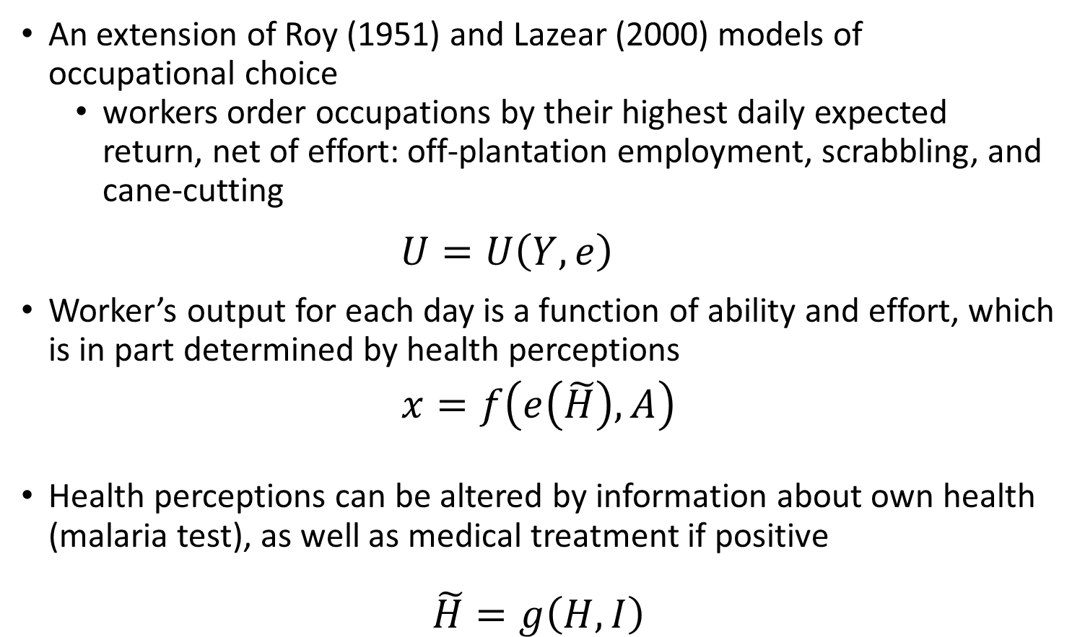
Worker’s decision
An extension of Roy (1951) and Lazear (2000) models of occupational choice
  workers order occupations by their highest daily expected return, net of effort: off-plantation employment, scrabbling, and cane-cutting
  $$U=U\left(Y,e\right)$$
Worker’s output for each day is a function of ability and effort, which is in part determined by health perceptions
$$x=f\left(e\left(\tilde{H}\right),A\right)$$
Health perceptions can be altered by information about own health (malaria test), as well as medical treatment if positive
$$\tilde{H}=g\left(H,I\right)$$

Slide 13
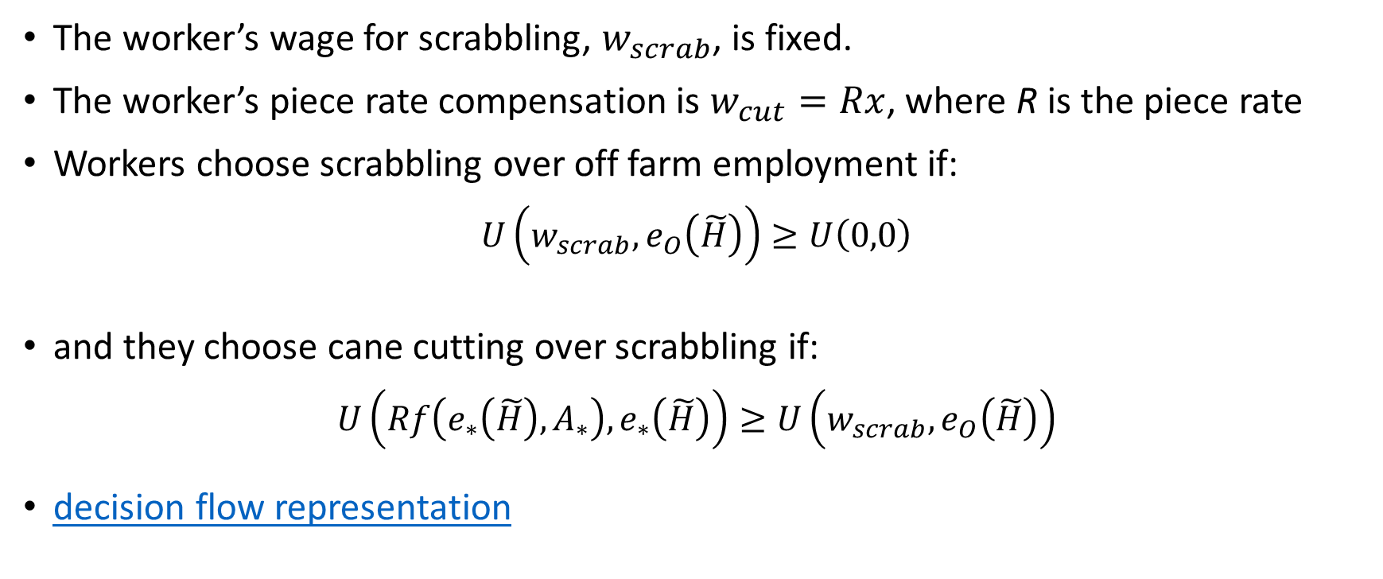
Worker’s decision
The worker’s wage for scrabbling, $w_{scrab}$, is fixed.
The worker’s piece rate compensation is $w_{cut}=Rx$, where R is the piece rate
Workers choose scrabbling over off farm employment if:
$$U\left(w_{scrab},e_{O}\left(\tilde{H}\right)\right)≥U\left(0,0\right)$$
and they choose cane cutting over scrabbling if:
$$U\left(Rf\left(e_{∗}\left(\tilde{H}\right),A_{∗}\right),e_{∗}\left(\tilde{H}\right)\right)≥U\left(w_{scrab},e_{O}\left(\tilde{H}\right)\right)$$
decision flow representation

Slide 14

Worker’s decision
Figure 1. Occupational selection as a function of ability and expected effort
Expected effort, e($\tilde{H}$)
Cane cutting
Scrabbling
U_{x*}
Off-plantation work
S2
S1
U_{x0}
Ability, A
Note: the expected maximum effort for workers S1 and S2 increases due to revisions of health beliefs as a result of new information. S1 now believes cane cutting is a profitable choice due to high ability endowment. S2 remains with his choice of scrabbling.

Slide 15
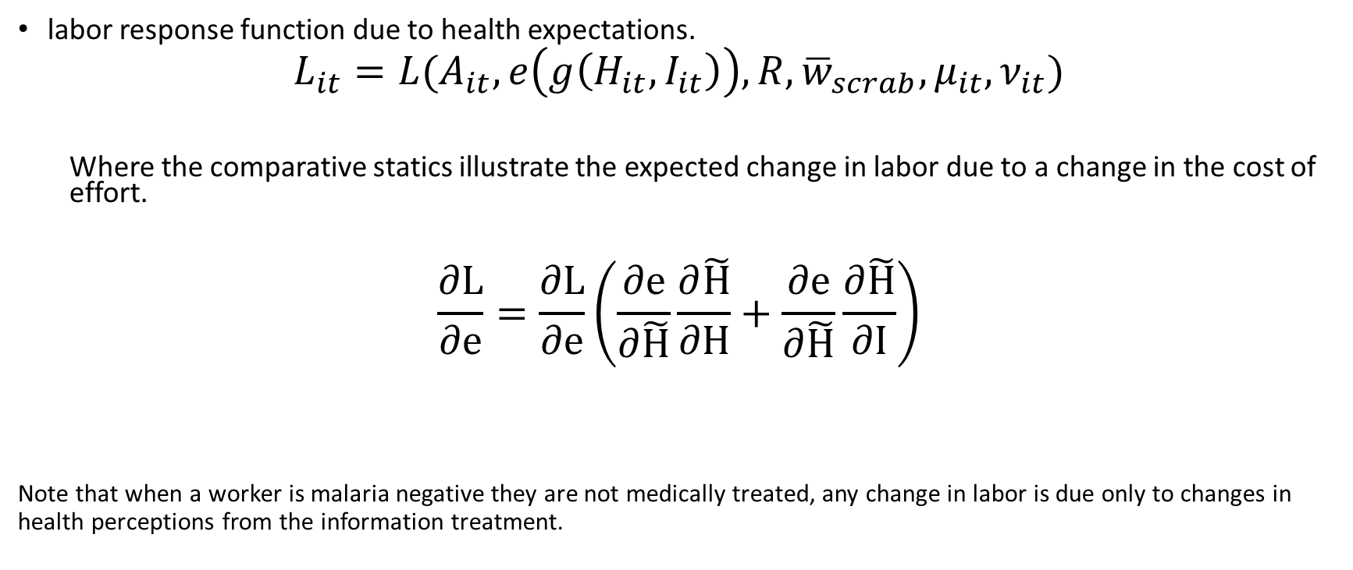
Worker’s decision
labor response function due to health expectations.
$$L_{it}={L(A_{it},e\left(g\left(H_{it},I_{it}\right)\right),R,{\overline{w}}_{scrab}, μ}_{it}, ν_{it})$$
  Where the comparative statics illustrate the expected change in labor due to a change in the cost of effort.
$$\frac{∂L}{∂e}=\frac{∂L}{∂e}\left(\frac{∂e}{∂\tilde{H}}\frac{∂\tilde{H}}{∂H}+\frac{∂e}{∂\tilde{H}}\frac{∂\tilde{H}}{∂I}\right)$$
Note that when a worker is malaria negative they are not medically treated, any change in labor is due only to changes in health perceptions from the information treatment.
Notes:
Decomposed into a ‘pure’ health effect and an information effect
We will give an external shock by providing access to testing and treatment in random order.
We provide access to testing and treatment
when people test positive, they receive a combined treatment: information and medical treatment
When people test negative: they get an information treatment

Slide 16
Empirical questions
Does access to workplace based malaria testing and treatment affect income, labor supply, and productivity? (ITT)
If malaria treatment leads to higher income, is this because of its effects on labor supply, productivity, or both? (TOT)
Apart from gains due to improvements in physical health, does the provision of health information affect labor decisions by changing expectations? (TmUT)

Slide 17
Experimental design
A mobile health clinic visits the workforce during working hours
Every sugarcane cutter is tested for malaria and, if positive, treated with ACT over the course of a 6 week study period. Follow-up protocol and incentives are provided to ensure ACT compliance.
Malaria tests are collected daily and processed in a nearby University lab.
Daily administrative earnings, labor supply and productivity is recorded from plantation records.
Conducted at peak of harvest season (Jan, Feb) 2011

Slide 18
Experimental design
The temporal order of worker testing is randomly assigned by the research group inducing exogenous variation in worker health over study period. All workers are tested and treated if positive during the study period.
Study design is blocked by workgroup; work group strata are important
Randomization across workers and over time worked well in terms of balance, resulting in approximately even distribution of respondent over time

Slide 19
Measurement and diagnosis of malaria
Diagnosis by microscopy from blood smear (WHO gold-standard)
This gives a measure of severity of infection, diagnosis known 3 days after specimen collection
  Metric is number of parasites observed in randomly selected blood field, diagnostic cut-off is 3 parasites
A digression on diagnosing malaria
64.1% Malaria -
35.9% Malaria +

Slide 20
Econometric strategy
We estimate three effects:
  Intent to treat effect (ITT): Effect of access to testing and medical treatment
  Treatment on the treated (TOT): Effect of testing and medical treatment for the malaria positives
  Treatment on the medically Untreated (TmUT): Effect of testing for the malaria negatives
  We use two specifications for each of these three effects:
  Within worker estimation, using daily labor outcomes, including worker fixed effects
  Between worker estimation, using weekly labor outcomes, including group by week fixed effects – this is the preferred estimator as it fully exploits the experimental design

Slide 21
Data structure
Stylised visualisation of staggered randomisation of the program treatment

Slide 23
Data structure
Stylised visualisation of staggered randomisation of the program treatment

Slide 24
Control for T5
Control for T4
Control for T3
Control for T2
Control for T1

Slide 25
Data structure integrating labor outcome measurement
Example for a worker treated in week 3

Slide 26
Data structure (Between Estimator, 1 Week)
we compare the week 4 y, ls, and w of workers treated in week 3
with the week 4 y, ls, and w of workers treated in week 5 (not yet treated in week 4)
Workers treated in week 3

Slide 27
Data structure (Within Estimator, 1 Week)
We compare the week 2 y, ls, and w of workers treated in week 3 (not yet treated in week 2)
with the week 4 y, ls, and w of those same workers (after treatment in week 3)
Link to two-week estimator visualizations

Slide 28
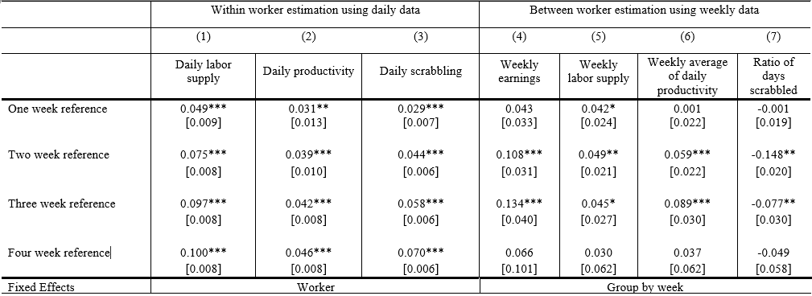
ITT results
Between estimator: 11-13% gain in earnings from treatment over 2-3 weeks, due in roughly equal measure to increased labor supply and increased productivity, and related to reducing scrabbling days
Largely confirmed by within estimator (note: scrabbling has upwards trend over time, so need to compare with average trend here)

Slide 29
ToT results (malaria+)
  We compare outcomes for parasitemic positive workers who received ACT with outcomes for workers who were sick during the same period, using information from future positive tests

Slide 30
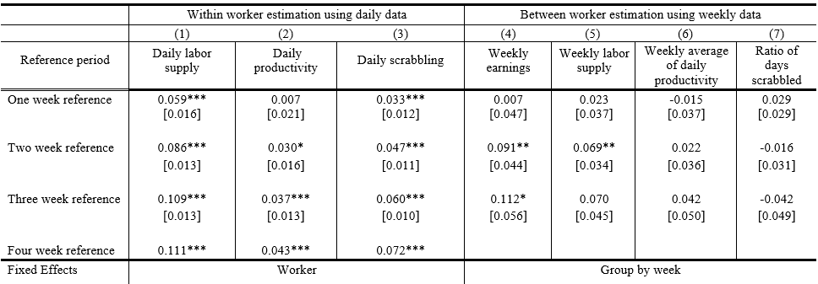
ToT results (malaria+)
Between estimator: 9-11% gain in earnings from medical treatment over 2-3 weeks, primarily due to increased labor supply
Largely confirmed by within estimator

Slide 31
ToT results (malaria+)
ToT captures gains from medical treatment; we expect greater responses among the more severely ill
  We find indeed larger ToT effects among those with parasite count 4 or more than among those with parasite count 3. Details here.

Slide 32
TmUT results (malaria-)
Between estimator: 12-14% gain in earnings arising from ‘good news’ about one’s own health over 2-3 weeks, primarily due to increased labor productivity, related to reducing scrabbling days
Largely confirmed by within estimator

Slide 33
TmUT results (malaria-)
TmUT captures gains from ‘good news’ about one’s own health
Arises at least in part due to switching from scrabbling into piece-rate cutting
  Consistent with a shift in perceived health and expected effort model
But gains are not only due to decreases in scrabbling
  We can restrict estimates to worker-weeks with no scrabbling and find non-zero impacts, details here
  Consistent with a health perceptions and revised expectations story
Are we mistakenly comparing certified healthy workers with some proportion of sick control workers (who recover and then test negative)
  Exclude any worker who reports any illness in the previous 4 weeks, detail here
  Again, consistent with a health perceptions and revised expectations story

Slide 34
TmUT results (malaria-)
The good health news seems to lead to occupational switching and higher worker productivity
  New health information has been known to affect subsequent behavior, at least in the case of HIV, where learning positivity status leads to safer practices (Boozer and Philipson, Thornton)
  But little literature concerning health status learning effects of acute illnesses
  Theory predicts (i.e. Gong 2012) that only surprises from new information should affect behavior – information that results in a change in expectations
    Workers with some parasites (but healthy diagnosis) are more subject to surprise and should show larger effects (see here)
    Workers with lower subjective perception of work capacity show larger effects (see here)

Slide 35
Potential threats to validity
Three potential threats to the validity of the ITT estimates:
  Workers’ health seeking behavior and effort change in response to the program
  There are epidemiological changes in response to the program
  The assumptions underlying the identification strategy are violated

Slide 36
Potential threats to validity
Is worker health seeking behavior affected by the study announcement at the start?
  Workers may adapt health seeking or preventive behavior, which may lead to a correlation between assigned interview date and labor outcomes
  But we find:
    Worker health characteristics, which are typically correlated with health seeking behavior and labor outcomes, are balanced between early and late interview date (here)
    We observe no decline in prevalence of malaria over study period
Do workers adapt their effort?
  Workers not yet tested may adjust effort in anticipation of a test, lowering labor outcomes of the control group
  But: Placebo test using lags of treatment, suggests they don’t, (here)
  Does treatment of a worker subgroup induce peer response (Mas & Moretti 2009)?
  Not in this setting: individual piece rate pay is independent of peer production

Slide 37
Potential threats to validity
Does the intervention itself lead to epidemiological change?
  Does increased access to treatment over the duration of the program reduce the infection rate of the work force, making workers healthier and more productive as the program is rolled out?
  But:
    We observe no decline in prevalence of malaria over study period
    Malaria transmission occurs mostly in the evening or night, when workers are in villages with large parasite reservoir
Is the key assumption for identification violated?
  We assume that a worker’s health status remains the same over the considered time interval (1 week, 2 weeks, 3 weeks). Is this assumption violated?

Slide 38
Potential threats to validity
  Is this assumption violated for malaria positive workers? Are workers who test positive at t+τ also positive at t?
    Biology of malaria infection makes the identification assumption credible
      an outbreak lasts 14-17 days with parasite maximizing in the blood one to three days before symptoms emerge, so the assumption is likely to hold for one and two week reference periods, as malaria positive treated workers will be compared with workers who are malaria positive; even for three week reference period a large proportion of workers is expected to satisfy this
    Workers with more severe cases (using parasite count rather than threshold) respond more strongly to treatment, supporting that the TOT reflects effect of malaria treatment

Slide 39
Potential threats to validity
  Is this assumption violated for malaria negative workers? Are workers who test negative at t+τ also negative at t?
  See earlier tests: Workers with some parasites (but healthy diagnosis) and workers with lower subjective perception of work capacity show larger effects

Slide 40
Summary
Offer of malaria testing and treatment increases the labor supply and productivity of the average worker
Earnings response for both the malaria positive, who receive medication, and malaria negative
The gains among the sick are largely due to increased labor supply, and greatest gains observed among the most sick
The gains among the healthy apparently due to a change in health perception and earnings expectations net of effort cost
Study constraints prevent estimating longer-term effects

Slide 41
Conclusion
Key to tackle health impacts of malaria.
  Nigeria alone counts for 30% of malaria. Increasing agricultural productivity is key, but areas with high potential for agricultural growth are also likely breeding areas for mosquitos that pass on malaria.
Estimated worker level benefit costs ratio of 1.3 for a 3 week period
  There may be further positive spillovers to the household in terms pof reduced disease transmission
  Reduced prices of ACT have fallen so will further improve BC ratio
Estimated employer benefits likely very positive as well.
  Reduction in production cost due to reduction in worker turnover
  Increase in aggregate productivity due to more reliable workforce
  Benefit cost ratio positive if absenteeism per worker is reduced by at least 1.2 days (valued at current pay) which is very likely.
Testing seems to raise benefits for both the ill and the healthy

Slide 42
Links to other work
A companion study further investgates effort and productivity of the workers by directly measuring physical activity using an accelerometer. (Akogun, et al, World Bank Review of Economics, and summary in this blog)
  validates those of the original study
  malaria positive workers, when receiving the malaria testing and treatment, increase daily productivity by reallocating effort from lower to higher intensity work
A second companion study replicates the results
  Replication of experimental study results are a primary concern in social sciences
  Most replications are across space and time
  Here the program is repeated twice on the same site, in two subsequent years, at the same time of the year, with mostly - but not fully - the same group of workers
  Results show overall replicability, with some variation over time due to
    Variation in epidemiological environment (malaria prevalance rates)
    Changes in labor contracts
    Changes in worker sample

Slide 43
Links to other work
The results raise a fundamental, yet familiar, question for policy making:
  Given the observed high returns to malaria testing and treatment, should this service be bought by workers themselves, offered by firms or subsidized by government?
We start to see some answer from further on-going work
If private returns to malaria care are high, we expect workers to have a high willingness to pay for malaria insurance, but another companion study finds mixed results (see here for a preliminary discussion).
  Demand is price sensitive with an elasticity of about -0.25. Worker willingness to pay for malaria insurance is measured by means of a lab-in-the field experiment employing a Becker-De Groot-Maarschak method.
  Offering malaria insurance has an average impact on productivity and earnings of about 5%, rising to about 25% for workers with low willingness to pay, who have lower ability and less favourable preferences, but not lower health. The estimation uses exogenously varied price as an instrument.

Slide 44
Links to other work
A Cost Benefit Analysis at the firm level strongly suggests substantial net benefits for the firm, in terms of reduced worker turn over and improved reliability of the workforce, allowing for improved planning and important efficiency gains.
Workplace provision of malaria care also has public benefits, and has promise as a component of a malaria control or eradication strategy, complementary to necessary population based strategies.
  Population based testing and treatment are critical components of malaria control and eradication programs. Standard community based approach has weaknesses including reaching working male adults during the day.
  Workplace treatment programs can help address this, just like complementary school based programs improve reach with students. (Halliday et al 2019)
  Firm provision can make malaria control and eradication programs more sustainable financially

Slide 45
Add-on slides

Slide 46
Existing evidence adult health and labor
HIV/AIDS reduces labour supply in Kenya, Botswana (Fox et al. 2004; Thirumurti et al., 2006;Habyarimana et al, 2010)
Schistomosiasis reduces labor supply in Mali (Audibert and Etard, 1998)
Pollution reduces worker output in US (Zivin, 2010)
Reduction in malaria exposure at an early age increases income later in life (Cutler et al, 2010; Bleakley, 2010)
Back
Notes:
Importance of agric productivity
Much attention for technological innovation,
now also for human capital and especially health
Does investment in health increase productivity?
and if so, by how much, and why do we not see more investment?
Macro studies
-Recent macro economic evidence suggests small effects of health on growth (Acemoglu and Johnson 2006; Ashraf, Lester and Weil 2008; Weil 2008)
-Negative relationship with GDP pc, savings, FDI (McCarthy et al (2000), Gallup and Sachs (2001); Sachs and Malaney (2002), Sachs (2003), Carsten and Gundlach (2006); Bhattacharyya (2009); Azemar and Desbordes (2009)-
But cross country regressions
A number of macro economic studies suggest that health in general and malaria in specific, can have strong effects on economic outcomes (a.o. Sachs, 2001)
But their evidence relies on cross country regressions which may suffer from omitted variable bias and reverse causality problems
Recent work on the effect of health on growth finds surprisingly small effects (Acemoglu, Johnson and Robinson (2001); Ashraf, Lester and Weil (2008); Weil (2008)
But little is known about the effects at the micro level.
(And we cannot conclude from the macro effects only that health is not important)
Macro observations can hide large micro economic effects
averaging out;
substitution effects,
non linear effects
Inverse effects of income on health may be large and bring about a poverty trap (Gollin and Zimmerman (2007); Bonds et al (2011)
One of the issues of interest is whether there is a poverty trap
Existence of poverty trap may be especially relevant for malaria in agricultural economies, as it is transmitted by mosquito’s which thrive in the presence of water
Investment in agriculture (irrigation, micro dams) increases mosquitos (Harb et al 1993; Thompson et al 1996) and malaria incidence
Perhaps a more structural approach is to pose the question at the micro level
Limited knowledge about effects at the micro level
In contrast to the relationship between education and labor outcomes, the health - labor nexus has traditionally received less attention.
Strauss and Thomas (1998)
Nutrition affects labour outcomes
nonexperimental (Strauss 1986; Sahn and Alderman 1989; Thomas and Strauss 1997)
experimental studies (Basta 1979; Immink and Vietri 1981, Wolgemuth et al 1998, Thomas et al 2006)
much remains to be done in order to understand
what dimensions of health matter,
and under which circumstances the effect is important.
Two challenges when you want to answer the questions whether investment in health increases productivity and income
multidimensional nature of health : measurement challenge and isolate effect and attribute causality
how to identify direction of causation
Two strands of literature
(We abstract from a third strand
- health investments during childhood affect labour outcomes later in life;
nonexperimental (Fogel 1994;Strauss and Thomas 1998; Ribero and Nunez 2000; Dercon and Porter 2010)
- health investment during child hood affect learning outcomes
experimental (Hoddinot and Behrman ? Guatemala
1. Nutrition affects labour outcomes:
nonexperimental:
Strauss 1986:
Sahn and Alderman
Thomas and Strauss: 1997: the effect of height on wages among men in Brazil
Experimental:
Duncan Thomas et al: iron supplements in Indonesia – double blind placebo – find effects on income
2. Diseases affect labour outcomes
Fox:
Goldstein: HIV among Kenyan tea pluckers
Schistomiasis: worm
Pollution affects breathing and other health problems, and this affactes productivity
We continue in the latter tradition and focus on one specific disease: malaria,
We investigate the effects of being treated for malaria on agricultural worker productivity, labour supply and income
but “much remains to be done” (Strauss and Thomas, 1998, JEL)
Limited knowledge about the effects of malaria on productivity
But may be of special relevance for agricultural growth in low income countries as investments in favorable agro-ecological areas or irrigation may increase mosquito breeding
=> potential constraint? (trap?)
Health and ec dev
How to measure improvement in health: what to focus on; health is multidimensional
Literature typically divided in effect of nutrition
Effect of specific diseases
How to attribute economic improvement to health improvement
How to test for a causal relationship
2 possible traps?
3. Key question:
Cutler 2010 AEJA: We examine the effects of exposure to malaria in early childhood
on educational attainment and economic status in adulthood by
exploiting geographic variation in malaria prevalence in India prior
to a nationwide eradication program in the 1950s. We find that the
program led to modest increases in household per capita consumption
for prime age men, and the effects for men are larger than those
for women in most specifications. We find no evidence of increased
educational attainment for men and mixed evidence for women
Bleakley 2010 AEJA: This study uses the malaria-eradication campaigns in the United
States (circa 1920) and in Brazil, Colombia, and Mexico (circa 1955)
to measure how much childhood exposure to malaria depresses
labor productivity. The campaigns began because of advances in
health technology, which mitigates concerns about reverse causality.
Malarious areas saw large drops in the disease thereafter. Relative
to non-malarious areas, cohorts born after eradication had higher
income as adults than the preceding generation. These cross-cohort
changes coincided with childhood exposure to the campaigns rather
than to pre-existing trends. Estimates suggest a substantial, though
not predominant, role for malaria in explaining cross-region differences
in income.
Zivin 2010: Environmental protection is typically cast as a tax on the labor market and the economy in general.
Since a large body of evidence links pollution with poor health, and health is an important part of
human capital, efforts to reduce pollution could plausibly be viewed as an investment in human capital
and thus a tool for promoting economic growth. While a handful of studies have documented the impacts
of pollution on labor supply, this paper is the first to rigorously assess the less visible but likely more
pervasive impacts on worker productivity. In particular, we exploit a novel panel dataset of daily farm
worker output as recorded under piece rate contracts merged with data on environmental conditions
to relate the plausibly exogenous daily variations in ozone with worker productivity. We find robust
evidence that ozone levels well below federal air quality standards have a significant impact on productivity:
a 10 ppb decrease in ozone concentrations increases worker productivity by 4.2 percent.

Slide 47
Malaria remains a significant illness
Estimated 210 million infections and ~1 million deaths per year
51% of households in Nigeria reported at least one episode of malaria (NLSS 2003/4) – in endemic settings, “malaria” often becomes a general term for illness/fever
Of special relevance for agricultural growth in low income countries as investments in favourable agro-ecological areas or irrigation may increase mosquito breeding
  Back
Notes:
20% of estimated malaria cases worldwide are found in Nigeria
One of three major diseases worldwide
transmitted by mosquito’s;
causes fever and headaches
Malaria infection leads to episode of fever, head aches
Malaria is a mosquito-borne infectious disease of humans caused by eukaryotic protists of the genus Plasmodium. It is widespread in tropical and subtropical regions, including much of SSA, Asia and the Americas. Malaria is very prevalent in these regions because they have significant amounts of rain fall and consistent hot temperatures. These warm, consistent temperatures and moisture provide mosquitos with the environment they need to breed continuously. The disease results from the multiplication of malaria parasites within red blood cells, causing symptoms that typically include fever and headaches, in severe cases progressing to coma, and death.
Four species of Plasmodium can infect and be transmitted by humans. Severe disease is largely caused by Plasmodium falciparum. Malaria caused by Plasmodium vivax, Plasmodium ovale and Plasmodium malariae is generally a milder disease that is rarely fatal. A fifth species,Plasmodium knowlesi, is a zoonosis that causes malaria in macaques but can also infect humans.[2][3]
Malaria transmission can be reduced by preventing mosquito bites by distribution of inexpensive mosquito nets and insect repellents, or by mosquito-control measures such as spraying insecticides inside houses and draining standing water where mosquitoes lay their eggs. Although many are under development, the challenge of producing a widely available vaccine that provides a high level of protection for a sustained period is still to be met.[4] Two drugs are also available to prevent malaria in travellers to malaria-endemic countries (prophylaxis).
A variety of antimalarial medications are available. In the last 5 years, treatment of P. falciparum infections in endemic countries has been transformed by the use of combinations of
drugs containing an artemisinin derivative. Severe malaria is treated with intravenous or intramuscular quinine or, increasingly, the artemisinin derivative artesunate [5] which is superior to quinine in both children and adults.[6]Resistance has developed to several antimalarial drugs, most notably chloroquine.[7]
There have been estimates on the economic costs of malaria
Mostly from by public health experts
Distinguish between direct and indirect costs
Direct: out of pocket expenses
Indirect only contains absenteeism from work
Not so much drop in productivity

Slide 48
Biological impacts
Malaria characterized by recurring fever, headache, muscle pain, and weakness/fatigue
Severe cases can result in encephalopathy and death - although likelihood of severity is much greater for young children
Malaria typically reoccurs unless treated
In past 5 years, dramatic global gains in malaria-related morbidity and mortality
Artemisinin combination therapy (ACTs), new treatment that is almost 100% effective
Notes:
There are good reasons to believe that malaria impacts on worker productivity

Slide 49
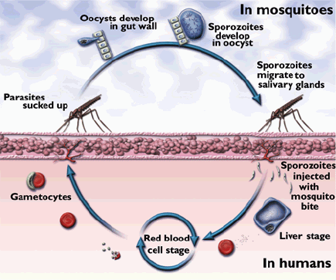
The malaria parasite lifecycle
  Back
Notes:
Oocysts: A thick-walled structure in which sporozoan zygotes develop and that serves to transfer them to new hosts.
(Sporozoan: Any of numerous parasitic protozoans of the class Sporozoa, most of which reproduce sexually and asexually in alternate generations by means of spores. They are frequently transmitted by bloodsucking insects to different hosts, where they cause many serious diseases, such as malaria and coccidiosis.
Zygote: 1. The cell formed by the union of two gametes, especially a fertilized ovum before cleavage.
2. The organism that develops from a zygote.
Gametocytes: A cell from which gametes develop by meiotic division, especially a spermatocyte or an oocyte
Gamete: A reproductive cell having the haploid number of chromosomes, especially a mature sperm or egg capable of fusing with a gamete of the opposite sex to produce the fertilized egg.
Five species of Plasmodium can infect and be transmitted by humans. The vast majority of deaths are caused by P. falciparum and P. vivax, while P. ovale, and P. malariae cause a generally milder form of malaria that is rarely fatal. The zoonotic species P. knowlesi, prevalent in Southeast Asia, causes malaria in macaques but can also cause severe infections in humans.
Falciparum is most serious

Slide 50
Observational estimates of cost per malaria episode
Study | Country | Cost of treatment (Direct cost) (% of total cost) | Absenteeism from work (Indirect cost) (% of total cost)
Morel et al. | Vietnam | US$ 0.7 (6%) | US$ 11.09 (94%)
Akazili et al. | Ghana | US$ 1.87 (29%) | US$ 4.52 (71%)
Deressa et al. | Ethiopia | US$ 1.60 (28%) | US$ 4.08 (72%)
Cropper et al. | Ethiopia | US$ 1.60 (7%) | US$ 22 (93%)
Sauerborn et al. | Burkina Faso | US$ 1.85 (31%) | US$ 4.11 (69%)
Ettling & Shepard | Rwanda | US$ 0.63 (28%) | US$ 2.25 (72%)
Asenso-Okyere et al. | Ghana | US$1.81 (21%) | US$ 6.87 (79%)
Cost of Absenteeism (indirect costs) is highest, but estimates derive from self-reports, valued at average wages, not including on-the-job costs. Furthermore, all based on observational data.
  Back
Notes:
Illustration
‘Indirect costs’ i.e. absenteeism from work is the highest cost
But shortcomings:
estimated from self-reporting,
cost is estimated by foregone earnings during absenteeism using average wage rates
only looks at absenteeism, not at drops in on the job productivity
We want to improve on this, and will measure the effect of malaria treatment on worker there look at

Slide 51
Measuring worker productivity
Precise measurement of individual productivity is a key challenge
Productivity generally defined as output divided by input: P = O/I
  Much analysis is at the aggregate level (firm, sector, economy wide), using production or value added (output) per worker (input).
    Example: analysis of productivity across firms tends to focus on average worker productivity by firm, typically constructed as value added divided by number of workers. It observes large dispersion of average worker productivity across business units, and across and within sectors of activity.
  But attribution to individual worker traits, including worker health, is not possible
Notes:
There are good reasons to believe that malaria impacts on worker productivity

Slide 52
Measuring worker productivity
Precise measurement of individual productivity is a key challenge
At the individual worker level, a directly observed measure of worker production (output) per unit of time (input) that is comparable across activities, is preferred.
  This is typically available in piece rate settings, where worker earnings provide a direct measure of a worker’s output.
  Outside piece rate settings, earnings, while correlated with productivity, are not necessarily a good measure for individual worker productivity
    Institutional factors such as unions, norms, job attributes and their desirability, worker characteristics have all been identified as co-determinants of wages – see the large labor economics literature on the role of unions and norms, implicit contracts, compensating differentials, efficiency wages
  Back
Notes:
There are good reasons to believe that malaria impacts on worker productivity

Slide 53
Measurement of illness
Morbidity is best measured through objective measurement of the pathogenic micro-organism causing the disease in the case of infectious diseases.^{(*)}
Self reported illness is error prone, and we cannot sign the bias a priori
  Recall bias
  Subjective perceptions of symptoms
  Lack of diagnostic capability - particularly when infection can be both symptomatic or asymptomatic
  Example: In our study, 29% of workers’ positive and 64% of workers’ negative self-reports, had accurate diagnosis – see Diagnosing malaria Appendix
^{(*)} In the case of chronic diseases objective measurement of symptoms is preferred, e.g. obesity (bmi>30), diabetes (sugar content of blood), stress (cortisol or other blood test)
Notes:
There are good reasons to believe that malaria impacts on worker productivity

Slide 54
Measurement of illness
Morbidity is best measured through objective measurement of the pathogenic micro-organism causing the disease in the case of infectious diseases.^{(*)}
Unfortunately, many studies still use self reported illness
  Clinical test bears extra cost: material cost (although falling rapidly), requires trained health personnel (although can help deliver improved health survey as well)
  Clinical test typically implies follow up treatment, and additional protocol, including emergency procedure in case of life threatening illness
  In some cases this is the best we have, but caution needed with interpretation
  Back
Notes:
There are good reasons to believe that malaria impacts on worker productivity

Slide 55
Staggered interventions
Strengths of the staggered intervention
  Unbiased estimation of ITT (access to treatment)
    phased in design yields observations for treated and untreated workers at same t, spread across the study period
  Estimation of Treatment on the Treated (ToT) effect for the malaria positive, provided we make an additional assumption
    ToT is standard in impact evaluation, medical science and public health
    ‘Treatment’ here is a bundled intervention of (i) news about infection and (ii) medical treatment
    Assumption: workers are positive at t if they are positive at time t+1; we investigate sensitivity of results to this assumption – this solves the ethical conundrum that we cannot withhold medical treatment from known infected workers to have a ‘perfect’ counterfactual at t
    Note that we only have imperfect information about the health status at t; we have full info about the labor status
  Estimation of Treatment on the Treated effect for the malaria negative, which, to avoid confusion, we call the Treatment of the medically Untreated (TmUT).
    ‘Treatment’ here is a ‘good news’

Slide 56
Alternatives to staggered interventions
Would an alternative study design yield superior impact estimates?
  would one shot intervention that offers a ‘pure counterfactual for ToT’ offer superior identification? (Dupas & Miguel, 2016)
  Robustness challenge: ITT, ToT and TmUT estimates would be prone to time specific effects
  Ethical challenge: withholding care from workers who are known to be infected is problematic (and would fail ethical approval)
  Logistical challenge: how to test all workers without disrupting production, which is itself an object of study
Note:
  the ‘imperfect’ counterfactual is for ToT and TmUT, not for ITT
  Can investigate the sensitivity of impact estimates to assumption
  Back

Slide 57
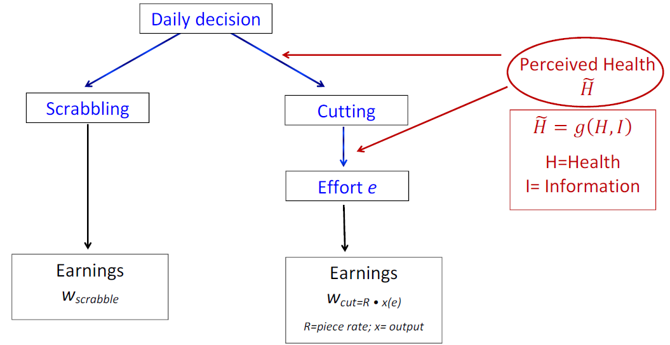
Worker’s decision
Health
  Back

Slide 58
Worker’s decision
Health

Slide 59
Worker’s decision
Health

Slide 60
Worker’s decision

Slide 61
Worker’s decision
  Back

Slide 62
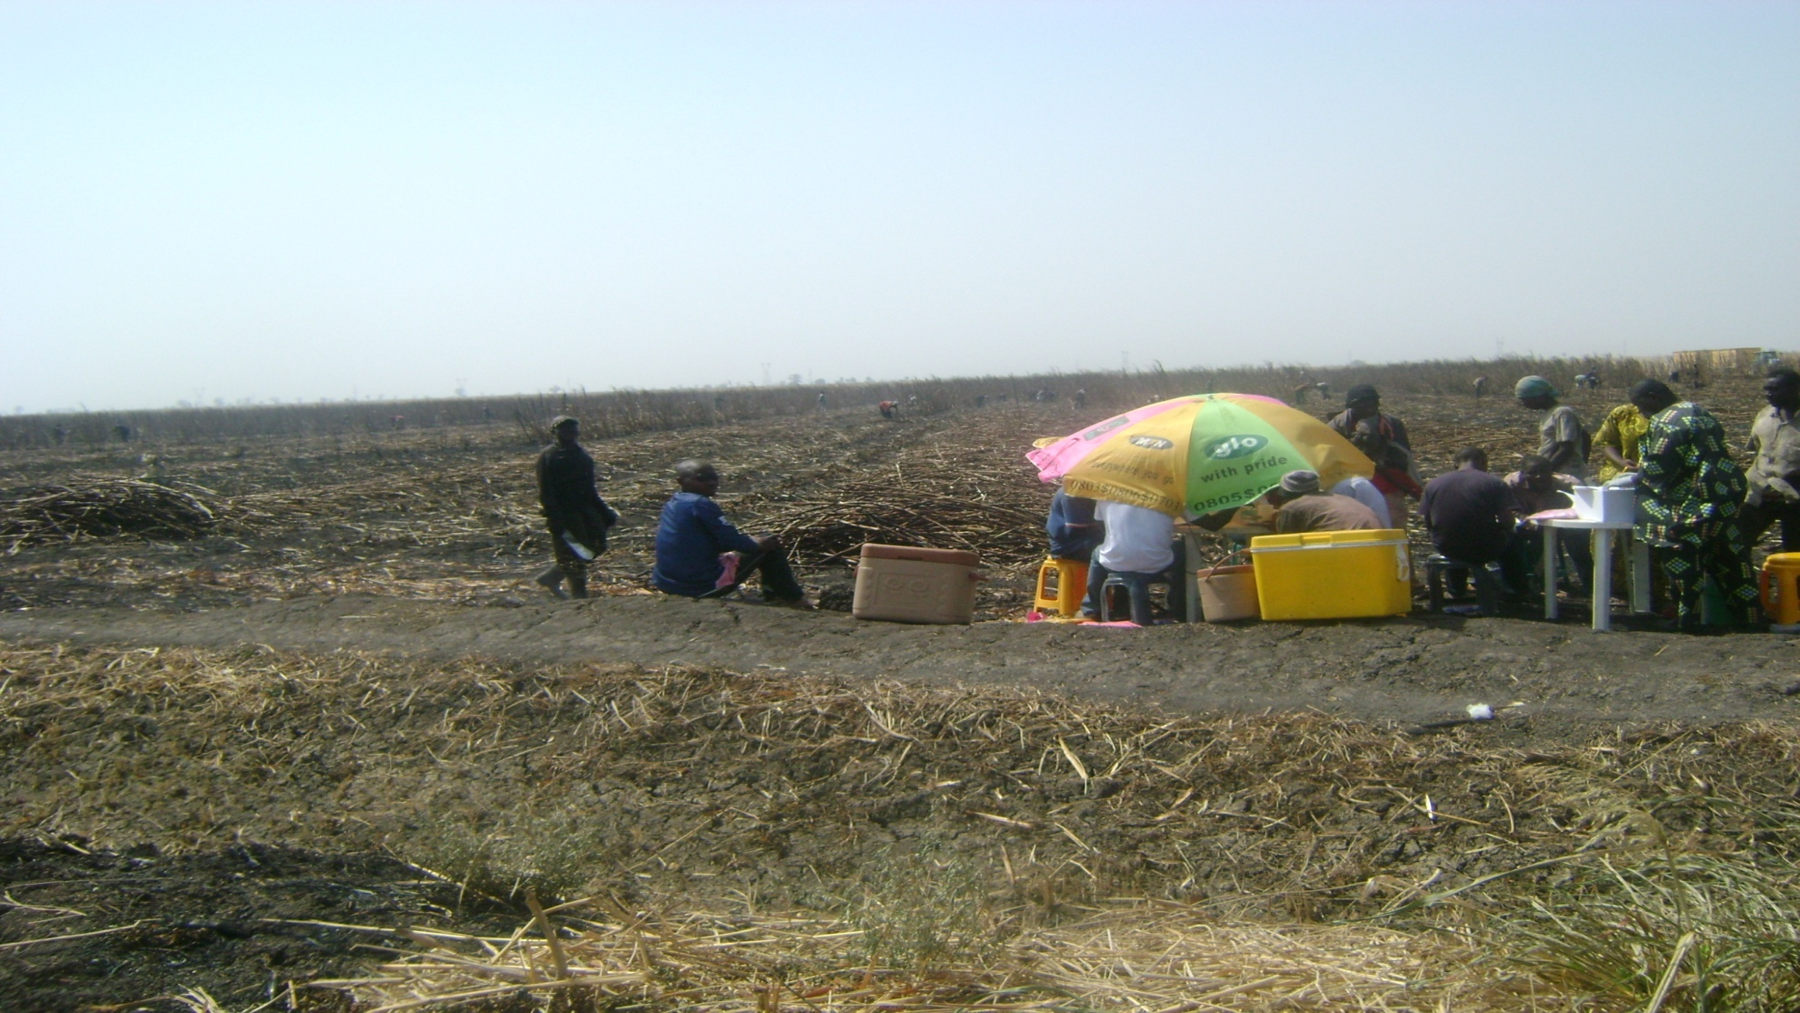
Health tests after clearing a field…

Slide 63
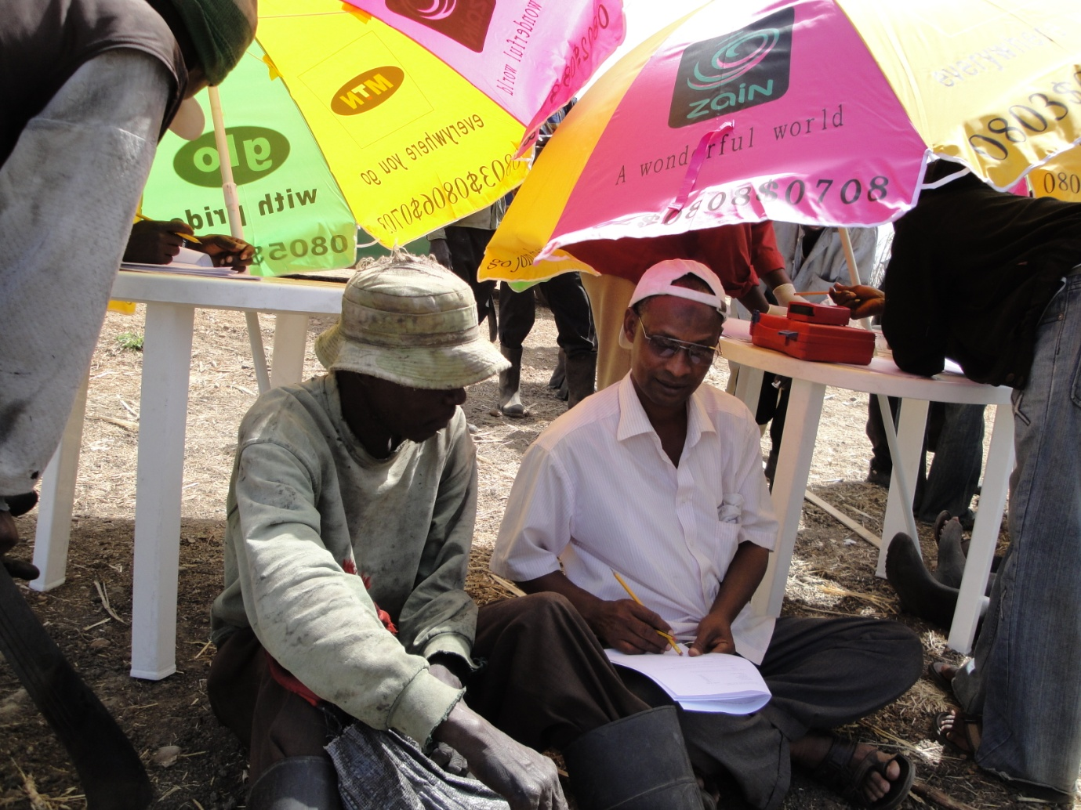
A health team visit…
  Back

Slide 64
Variation across work groups
Mean and standard deviation of weekly earnings, and daily conditional earnings by work group
  Back

Slide 65
Worker characteristics balanced
  Back

Slide 66
Balance across survey week
Mean and standard deviation of weekly earnings, and daily conditional earnings by work group
  Back

Slide 67
Respondent distribution across survey week
  Back

Slide 68
Diagnosing malaria
Malaria infection can be asymptomatic: one carries the parasite but has no symptoms. Asymptomatic malaria is common in endemic areas.
Self-diagnosis is error prone. In our study, 29% of workers’ positive and 64% of workers’ negative self-reports, had accurate diagnosis
  In endemic settings “malaria” is often taken as a wider assignation of general illness, especially illness accompanied by fever. Other diseases with the same symptoms can be erroneously self-diagnosed as malaria (cf. flu in colder climates, where people often describe a cold as a flu).
Best practice for malaria diagnosis is through a blood test
  A professional lab technician reads slide and records # parasites in 5 viewing fields. Senior lab supervisor double checks.
  The local threshold of 3 parasites is used as cut off to define malaria infection
    Studies use distinct thresholds across settings since there is no unique medically established standard. WHO recommends following local standards for the clinical threshold as the objective measure.
In this context tests can reveal new information about infection for each worker
  Back
Notes:
There are good reasons to believe that malaria impacts on worker productivity

Slide 69
Intent to Treat (ITT) effect
  The between estimator compares outcomes for workers who were offered access to testing and treatment with outcomes for those who had not yet been offered access to testing and treatment
  Where W(T_{i,τ-} =1) is the set of workers assessed before period τ
  W(T_{i,τ+} =1) is the set of workers assessed after period τ
  F_{gt} are work group – work week fixed effects
  The within estimator compares outcomes after offered access to testing and treatment with outcomes for the same worker before offered access to testing and treatment
  F_{i} are worker fixed effects
  Back

Slide 70
Treatment on the Treated (ToT) effect
(Malaria +)
  The between estimator compares outcomes for workers who tested positive with outcomes for those who had not yet tested positive (but tested positive just before)
  Where M⁺ Ware those who tested positive
  The within estimator compares outcomes after testing positive with outcomes for the same worker before testing positive
  Back

Slide 71
Treatment on the Medically Untreated (TmUT) effect (Malaria -)
  The between estimator compares outcomes for workers who tested negative with outcomes for those who had not yet tested negative (but tested negative just before)
  Where M⁻ Ware those who tested positive
  The within estimator compares outcomes after testing negative with outcomes for the same worker before testing negative
  Back

Slide 72
ToT by parasite count
  Back

Slide 73
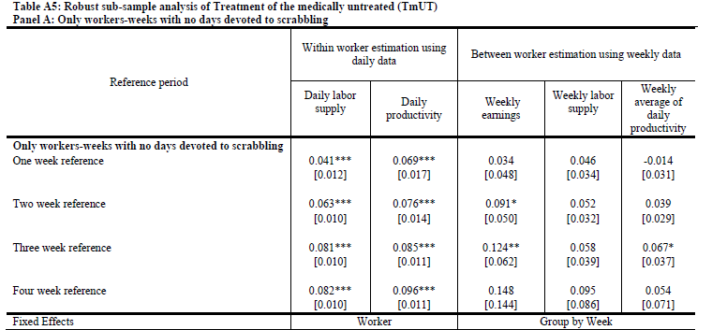
TmUT for workers who never scrabble
  Back

Slide 74
TmUT for workers with no recent illness
  Back

Slide 75
TmUT as surprise effect
  Back

Slide 76
Worker health and health seeking behavior over time

Slide 77
Worker health seeking behavior by timing of interview
  Back

Slide 78
Worker health seeking behavior by timing of interview
  Back

Slide 79
Data structure (Between Estimator, 2 Week)
we compare the weeks 4 & 5 y, ls, and w of workers treated in week 3
with the week 4 & 5 y, ls, and w of workers treated in week 5 (not yet treated in week 4)
Workers treated in week 3

Slide 80
Data structure (Within Estimator, 2 Week)
We compare the weeks 1 & 2 y, ls, and w of workers treated in week 3 (not yet treated in weeks 1 & 2)
with the weeks 4 & 5 y, ls, and w of those same workers (after treatment in week 3)

